Slide 1
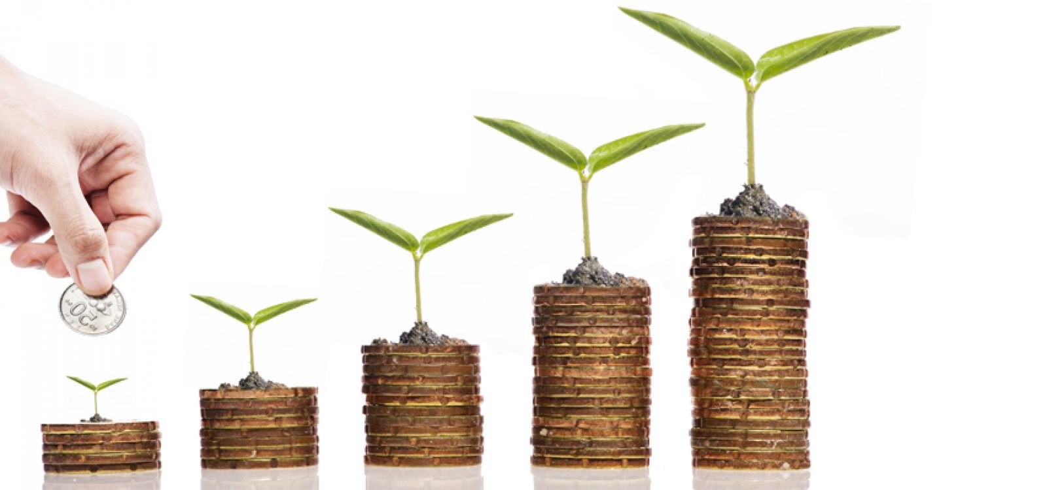
Nifty - 50 stock price prediction
Group Members:-
Shubham Shrivastava (PD14_221)
Adil Adnan (pd13_355)
Hammad Hussain (PD14_017)
Ujwal Dhok (PD14_117)

Slide 2
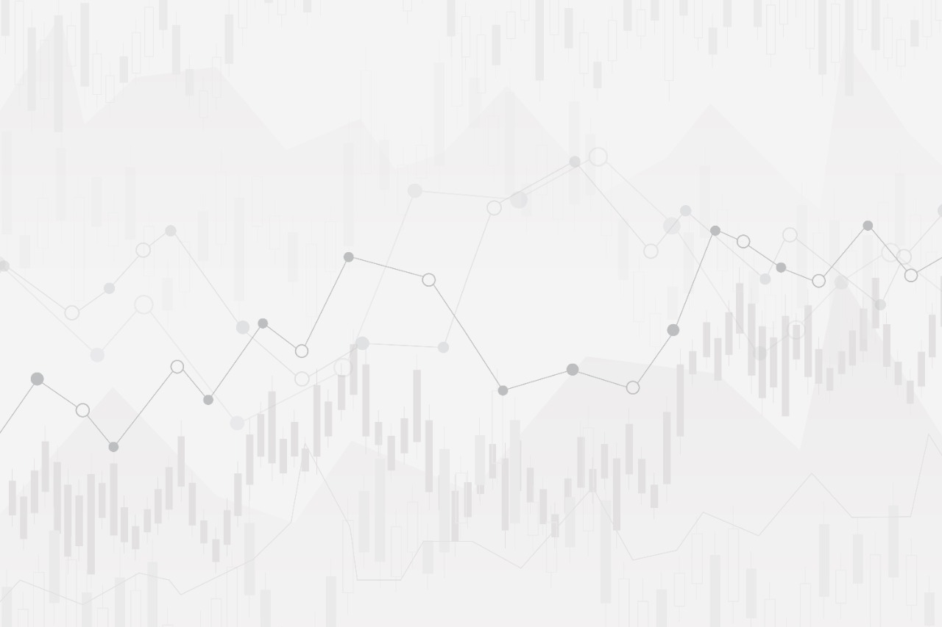
Introduction

Slide 3
Dataset
Aim of Project
Calculate the overall returns on their portfolio using google sheets.
User will give all the input in the google sheets and the final output should be populated in the sheet itself.

Slide 5
Insights

Slide 6
Process
Frist we are scrapped data using python libraries selenium and beautifulsoup, we have scrapped data of 50 stocks of nifty 50 index for last 4 years Then with help of gspread connected Excel files and worksheets
Created dataframes for different worksheets and calculations and data cleaning
Updated the sheet with help of gspread

Slide 7
Challenges
We need to figure out how to connect sheet to Notebook as well as extract data from those sheet to analyse.
We hWe have to get the basic knowledge of HTML to scrap the data
ave to get the basic knowledge of HTML to scrap the data
Wdasde have to get the basic knowledge of HTML to scrap the data
We have to get the basic knowledge of HTML to scrap the data
We have to get the basic knowledge of HTML to scrap the data
We had to clean data so we can calculate the values and fill it in sheet.
We overcame those challenges by finding resources and applying them on our projects.
For this purpose we used google api services and gspread module of python to extract data as well as update them into sheet.
Further cleaning of data was done with help of pandas library of python as well as calculation for values

Slide 8
Learnings
We learned to connect sheet and extract data from google sheets as well as update those sheets.
Along with that we learned to create dynamic values based on value in dashboard.
Also helped us gain some financial knowledge needed for analysis of stocks and markets.
Data cleaning and Data analysis specific to project

Slide 9


